Slide 1

센서 퓨전 및 시선 추적기를 이용한
차량의 주변 물체 및 운전자의 주의 집중 물체의 탐지
연구 책임자 :
연구 참여자 :
이상헌 교수
현석종 (발표자)
김지훈 (발표자)
김규빈 요원
김성민 병장
선민혁 상병
이지원 병장

Slide 2
연구동기

Slide 3

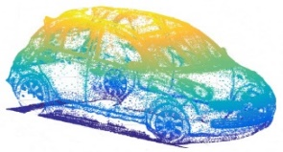
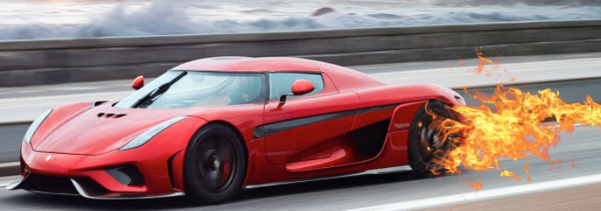
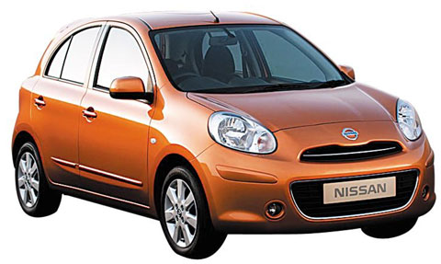
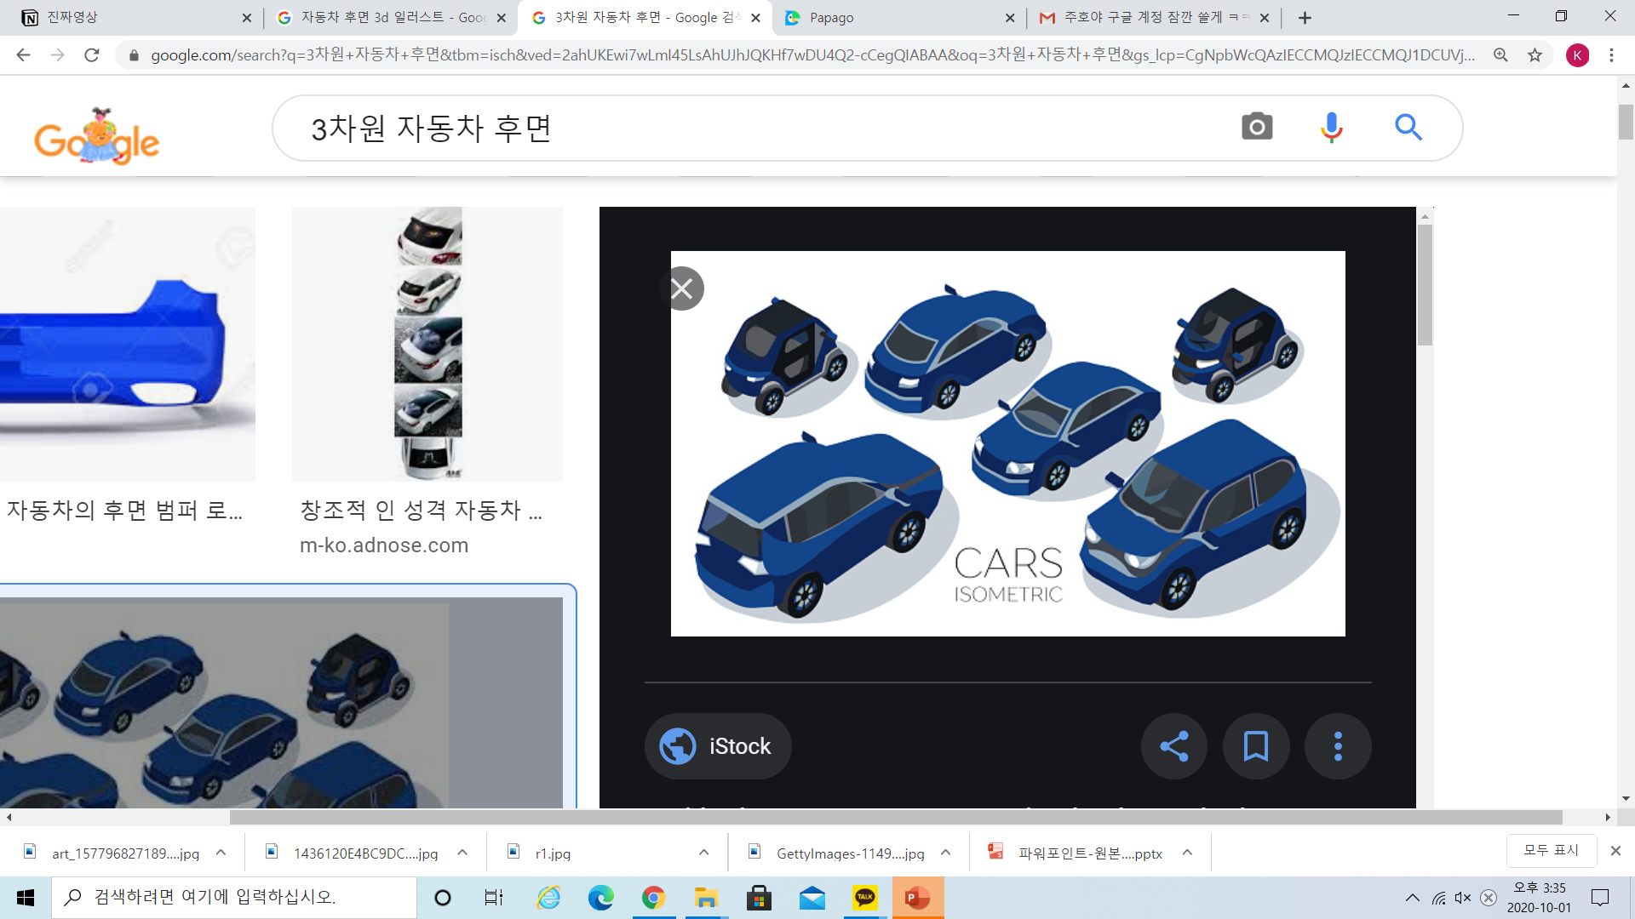
EyeTracker, LIDAR, CAMERA, CAN, Integration
{"ts":3170660907,"s":0,"gidx":52598,"l":119702,"gp":[0.5377,0.2307]}
Using real time coordinates of the Eye-tracker.
You can see which vehicle the driver sees.
Even the sudden appearance of a vehicle around you.
If the driver is not aware of a dangerous situation, the system alerts the driver with a warning sign or a sound.
This system reduces the driver's risk and prevents accidents.
Lidar Point Cloud
(3D)
Warning
Eye Tracker Vector
Driver’s sight
360º camera
screen (2D)

Slide 4
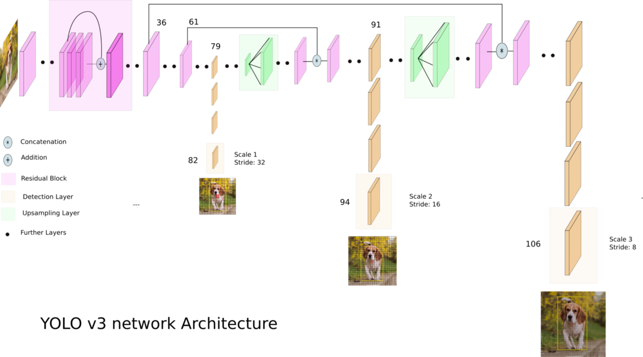
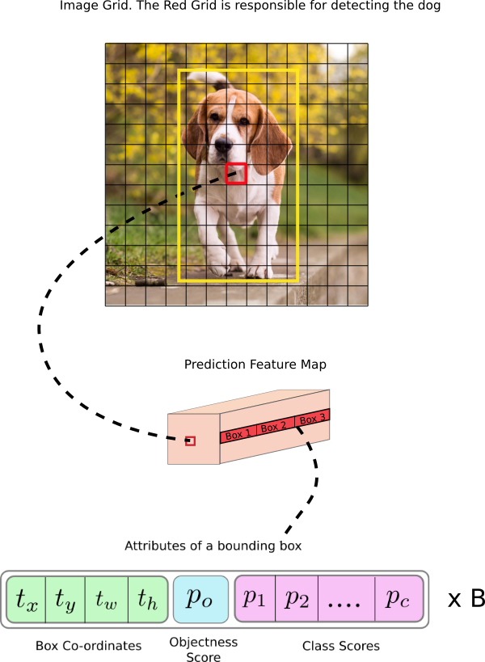
EyeTracker YOLOv3

Slide 5
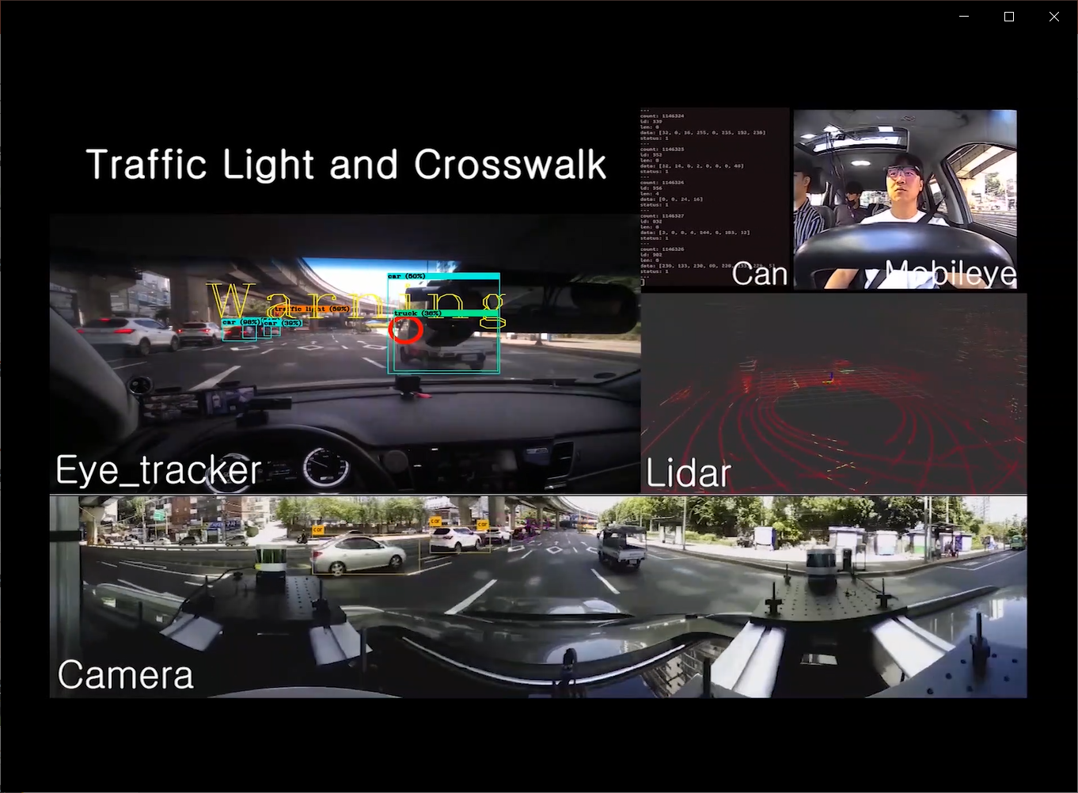


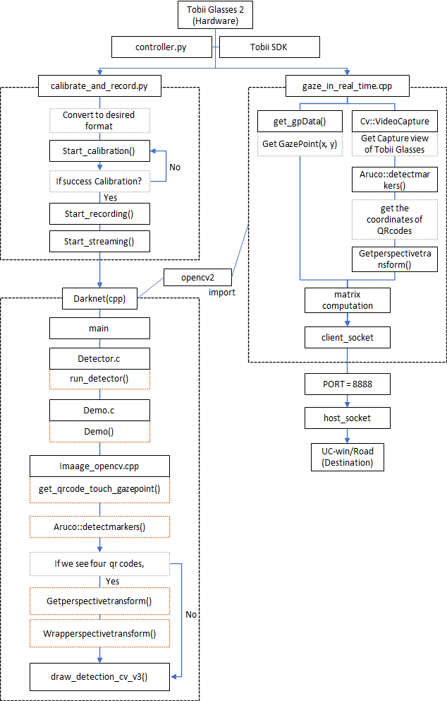
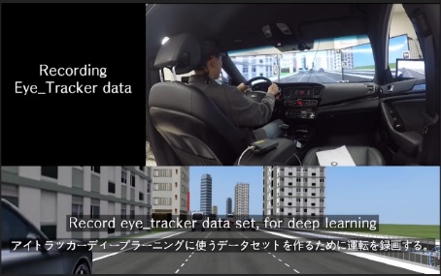
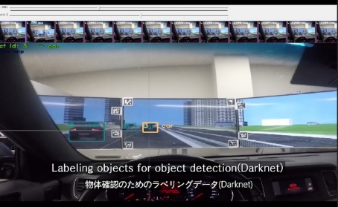
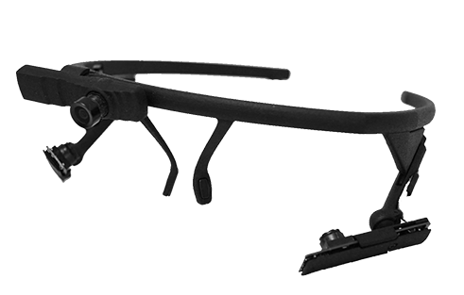

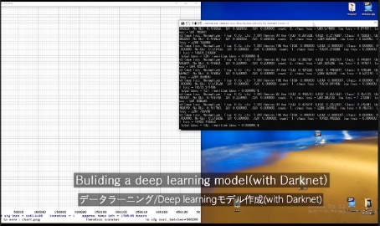
EyeTracker Darknet
Darknet
Step 1.
Record Eye_tracker set, for deep Learning
Step 2.
Labeling objects for object detection(Darknet)
Detector.c
image_opencv.cpp
IPv6
Eye Tracker
Demo.c
draw_detection_cv_v3()
Pupil Labs Core
Eye Tracker
user
Step 3.
Building a Deep Learning model(Darknet)

Slide 6

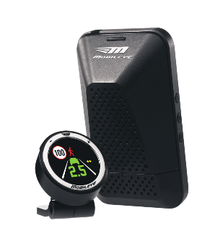

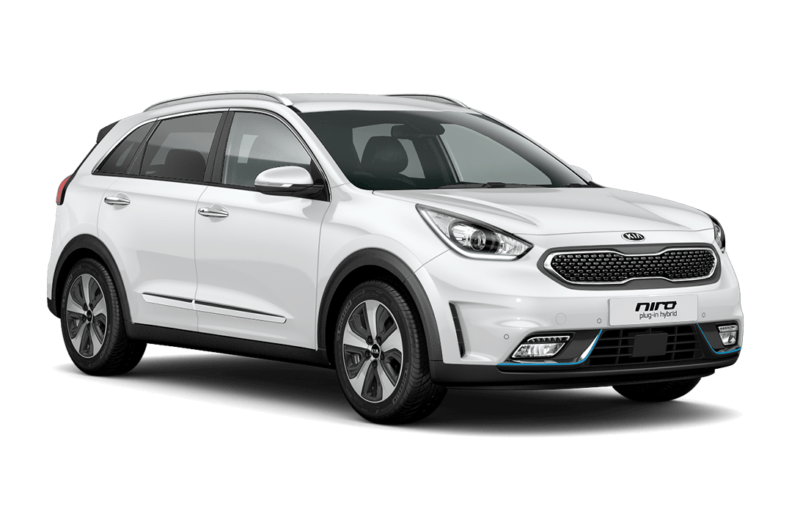
CAN Mobileye Surround Detection
Keep quering,
and get a myriad of answers simultaneously.
Mobileye
ADAS System
Kvaser leaf light v2
CAN USB Interface
USER
CAN
BUS Line
CAN Bus Line
Query
Answer
User
Among the answers, we choose and use the answers of the Arbitration ID we want.
Niro
Kia

Slide 7
LIDAR Euclidean clustering

Slide 8


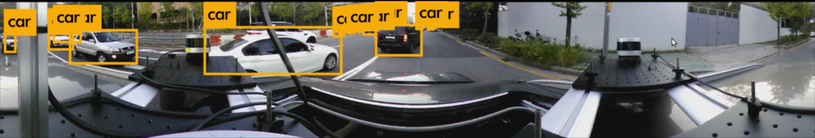
CAMERA Object detection
Image
Image_raw
YOLOv3
ROS
Ubuntu 18.04 melodic
V.360
Camera
2D Object detection result

Slide 9
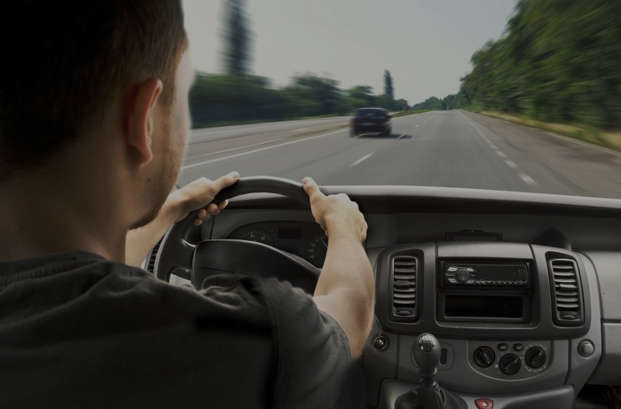
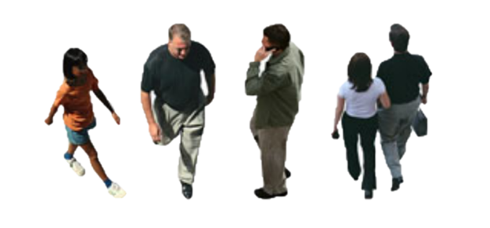
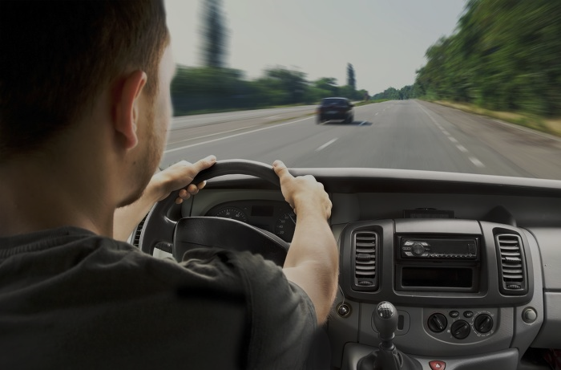
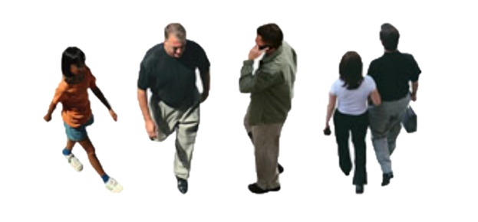
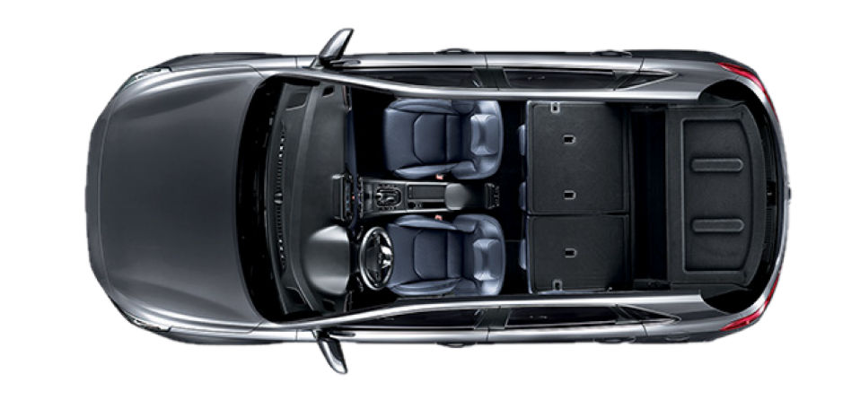
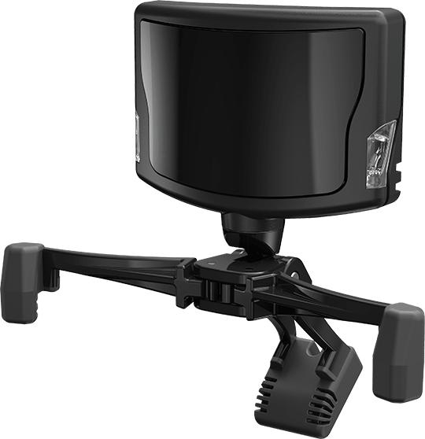


Development Direction Real-time Gaze Point Acquisition
Head Vector
Gaze Vector
$$φ$$
Driver
$$θ$$
Car Center
We can see where the driver is looking through head vectors and field vectors. Zero global coordinates to the center of the car, zero regional coordinates to the driver.
TrackIR
HeadTracker

Slide 10
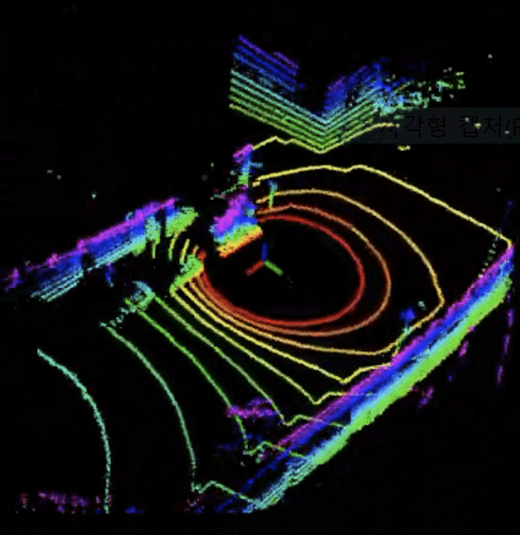
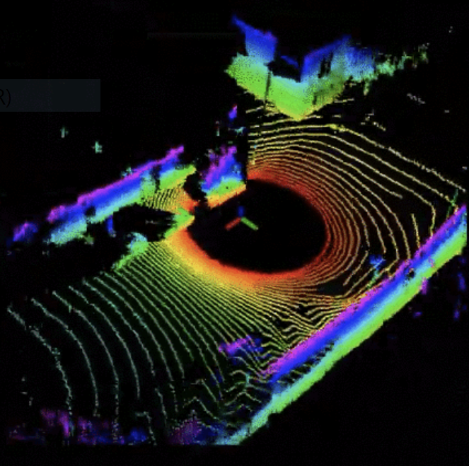
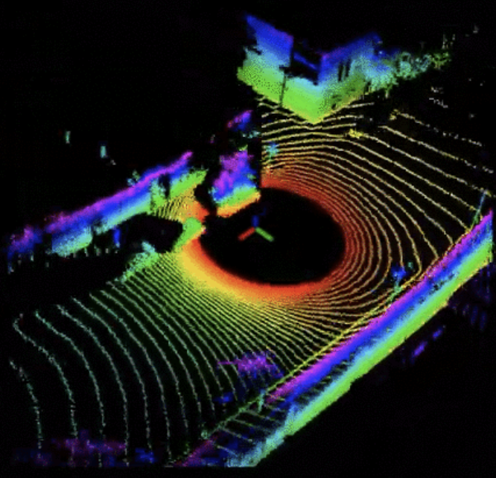
Development Direction LIDAR Super resolution
16-channel input
64-channel prediction
(4* upscaling – 16 to 64)
Ground truth

Slide 11
Development Direction F_convnet

Slide 12
● THANK YOU FOR YOUR ATTENTION ●
If you have any questions, please ask.

Slide 13


$$φ$$
$$θ$$
작업판
목차
카메라 2d yolo v3
Lidar 유클
Eyetracker Darknet
통합(can, camera, lidar)
앞으로
실시간
Super resolution
라이다
F_convnet
Shlee 셀카

Slide 14
PPT PRESENTATION
Enjoy your stylish business and campus life with BIZCAM
CONTENTS A
컨텐츠에 대한 내용을 적어요
Enjoy your stylish business and campus life with BIZCAM
01
CONTENTS A
컨텐츠에 대한 내용을 적어요
Enjoy your stylish business and campus life with BIZCAM
CONTENTS
CONTENTS
01
01
CONTENTS
CONTENTS A
컨텐츠에 대한 내용을 적어요
Enjoy your stylish business and campus life with BIZCAM
CONTENTS
CONTENTS A
컨텐츠에 대한 내용을 적어요
Enjoy your stylish business and campus life with BIZCAM
01

Slide 15
PPT PRESENTATION
Enjoy your stylish business and campus life with BIZCAM
01
02
CONTENTS A
컨텐츠에 대한 내용을 적어요
Enjoy your stylish business and campus life with BIZCAM
CONTENTS A
컨텐츠에 대한 내용을 적어요
Enjoy your stylish business and campus life with BIZCAM
CONTENTS A
컨텐츠에 대한 내용을 적어요
Enjoy your stylish business and campus life with BIZCAM
CONTENTS A
컨텐츠에 대한 내용을 적어요
Enjoy your stylish business and campus life with BIZCAM
03
04

Slide 16
PPT PRESENTATION
Enjoy your stylish business and campus life with BIZCAM
first quarter
75%
first quarter
75%
first quarter
75%
first quarter
75%
CONTENTS A
컨텐츠에 대한 내용을 적어요
Enjoy your stylish business and campus life with BIZCAM
CONTENTS A
컨텐츠에 대한 내용을 적어요
Enjoy your stylish business and campus life with BIZCAM
CONTENTS A
컨텐츠에 대한 내용을 적어요
Enjoy your stylish business and campus life with BIZCAM
CONTENTS A
컨텐츠에 대한 내용을 적어요
Enjoy your stylish business and campus life with BIZCAM

Slide 17
PPT PRESENTATION
Enjoy your stylish business and campus life with BIZCAM
 | CONTENTS | CONTENTS | CONTENTS
CONTENTS | 컨텐츠에 대한 내용을 적어요 | Enjoy your stylish business and campus life with BIZCAM | 1순위
CONTENTS | 컨텐츠에 대한 내용을 적어요 | Enjoy your stylish business and campus life with BIZCAM | 3순위
CONTENTS | 컨텐츠에 대한 내용을 적어요 | Enjoy your stylish business and campus life with BIZCAM | 2순위
CONTENTS | 컨텐츠에 대한 내용을 적어요 | Enjoy your stylish business and campus life with BIZCAM | 5순위
CONTENTS | 컨텐츠에 대한 내용을 적어요 | Enjoy your stylish business and campus life with BIZCAM | 4순위
60^
Check
60^
Check
CONTENTS
Enjoy your stylish business and campus life with BIZCAM
Microsoft Office PowerPoint is the presentation program used the most in the world.
CONTENTS

Slide 18
PPT PRESENTATION
Enjoy your stylish business and campus life with BIZCAM
CONTENTS
75%
CONTENTS
75%
CONTENTS
75%
CONTENTS A
컨텐츠에 대한 내용을 적어요
Enjoy your stylish business and campus life with BIZCAM
CONTENTS A
컨텐츠에 대한 내용을 적어요
Enjoy your stylish business and campus life with BIZCAM
CONTENTS A
컨텐츠에 대한 내용을 적어요
Enjoy your stylish business and campus life with BIZCAM

